Slide 1
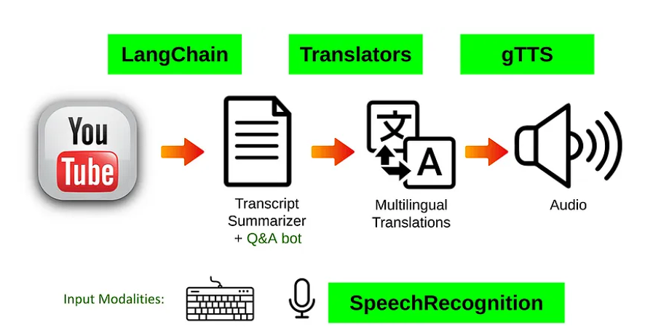
Multi Language YouTube Transcript Summariser Project
PRESENTED BY - Nitish Sharma (2102400109015)

Slide 2
Table of Content
Abstract
Purpose
Scope
Overall description
Function requirements definition
User cases
User characteristics
Hardware and Software Requirements in detail System Analysis and Design
Study & Weaknesses of current system
Requirements of new system
Features of new System
Data flow diagram
UML Model
E-R diagram
Screen Shots
Limitations Future
Enhancements
Conclusion
Bibliography

Slide 3
Purpose
Introduction
This Software Requirements Specification (SRS) outlines the complete functions and specifications of the Chrome Extension YouTube Transcript Summarizer. This project involves the creation of a Chrome Extension that sends requests to a backend REST API. The API performs Natural Language Processing (NLP) to generate and return a summarized version of a YouTube transcript.
Project Scope
With the exponential increase in video recordings shared online daily, finding relevant information has become time-consuming. Long video durations often lead to wasted effort if the content isn't pertinent.
Our project aims to address this by automatically summarizing video transcripts. This enables quick identification of key patterns and important content, saving considerable time and effort. Automated transcript summarization streamlines the process, allowing efficient extraction of valuable insights from video content.

Slide 4
Overall Description
YouTube Transcript Summarizer
The YouTube Transcript Summarizer Chrome Extension is designed for anyone looking to save time by quickly finding and accessing the content they need. Instead of watching numerous irrelevant videos that appear during a search, this extension provides a concise summary of YouTube videos in text or audio format, based on user preference.
Example:
Consider a student who needs to understand a particular topic for their studies. This extension transcribes the audio, generates subtitles, and summarizes the video's content, making it easier and faster for the student to grasp the topic. The key benefit is that this extension facilitates efficient learning and note-taking by providing quick and simplified summaries.

Slide 5
Functional Requirements Definitions
Functional Requirements: These refer to the functionality of the system, detailing the services it will provide to the user. Non-functional (supplementary) requirements pertain to additional information needed to produce the correct system and are detailed separately
Use Cases
This system is designed to cater to various user needs, including summarizing YouTube videos, videos from websites, and video conferences from different regions with diverse languages, enabling users to understand content in their preferred language.
User can do the following functions in the Chrome Extension
Summarization in text: Provides a text summary of the video content.
Summarization in audio: Offers an audio summary of the video content.
Make notes: Allows users to take notes based on the video summary.
Understand the main highlights: Identifies and presents the key points from the video.
Create questionnaires for exam purpose: Generates questions based on the video content for study and exam preparation.

Slide 6
User characteristics
The user should be familiar with YouTube videos, Subtitles.
Chrome Extensions to be able to use them and download them and understand its working and features to use it.
The user should be familiar with Chrome (google).
Constraints
The video should not be long enough because of limited word limit criteria, else it might throw error and not generate summary.
Multilingual support function in audio summary is not available in Extension.
Hardware and Software Requirements in detail
Hardware Requirements:
Processor: All
Chrome Browser (92,93):with the updated versions if not the most latest.
RAM :All
Hard Disk :All
Disk space :All

Slide 7
Software Requirements
Microsoft Visual Studio is an integrated development environment (IDE) used to develop console and GUI applications, Windows Forms, websites, web applications, and services. It supports native and managed code for platforms including Windows, Windows Mobile, .NET Framework, and Silverlight.
Python 3.10
Python 3.10 is the latest version of the Python programming language, featuring enhanced capabilities and performance improvements.
Pipeline Flask, flask_RESTful
JS, HTML, JSON compiler installed in vscode.
NET Framework 4.8 or nearest below to 3.5
Natural language processing
Transformers
YoutubeTrasncriptApi
Tensor flow
Chrome browser (92,93) versions

Slide 8
Study & Weaknesses of Current Working/Processing
Current Working/Processing
The current performance of the extension is suboptimal in terms of speed and accuracy. Summarization is only available for videos with subtitles. Additionally, the audio summary for these videos lacks accuracy, and text summaries for very short videos are excessively brief
Weaknesses in Current System
The current performance of the extension is suboptimal in terms of speed and accuracy. Summarization is only available for YouTube videos with built-in subtitles. Additionally, the extension has a 1024-word limit, causing errors with larger videos. Furthermore, larger videos cannot produce audio summaries.

Slide 9
Requirements of Updated version
Speed
Accuracy
Larger videos eligible for summarization.
Summarization of no-subtitle eligible videos.
User Requirements
The User requirements to recommend this extension to others and tell the admin by emailing the working and feedback.
Time can be saved in text summarizations Feedback.
Proper internet connection clear audio.
Feasibility Study
A key part of the preliminary investigation that reviews anticipated costs and benefits and recommends a course of action based on operational, technical, economic, and time factors. The purpose of the study is to determine if the systems request should proceed further.

Slide 10
Features of the New System
The new system has been designed as per the user requirements so as to fulfil almost all them. Speedy Processing
Summary can be generated very quickly as compared to the existing extension as it allows the use of
previously generated summaries to see again with data stored on cloud. It saves time required to get the summarization of audio and text faster.
Accuracy
One of the most important draw backs of the current system is that audio is not at its best accuracy
and can’t be generated on longer size videos because of word limit. The new system will generate the
result as soon as the summarization is processed by user and will also store it in the database for future usage.
High-quality Audio
The new system makes it easy to store and retrieve information as required and does not involve
storing information by the user-self its on Auto mode from cloud. It thus saves data management
problems faced in the current system as it has a Database Management System of only one-time access.
Zero Cost and No Advertisements
Unique service provider this extension as it does not show any advertisements and provide no-cost service.

Slide 11
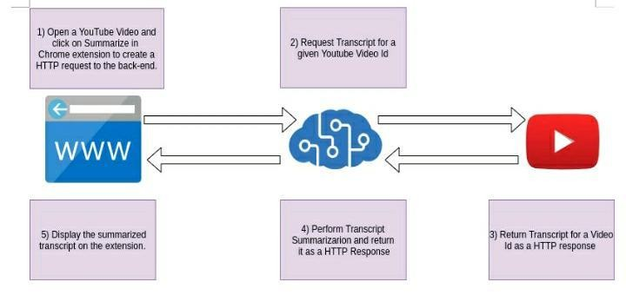
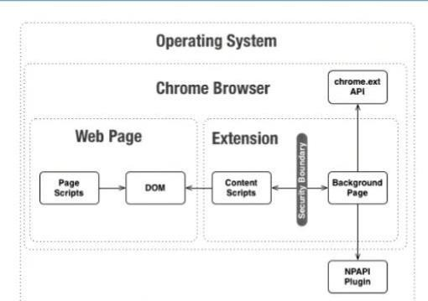
Data Flow Diagram (DFD)
The DFD (also known as bubble chart) is a simple graphical formalism that can be used to represent a system in terms of the input data into the system, various processes carried on these data, and the output data generated by the system.
The main reason why the DFD technique is so popular is because the fact that the DFD is a very simple formalism – it is simple to understand and use.
A DFD model uses a very limited number of primitive symbols to represent the functions performed by a system and the data flow among the functions.
Starting with a set of high-level functions that a system performs, a DFD model hierarchy represents various sub-functions.

Slide 12
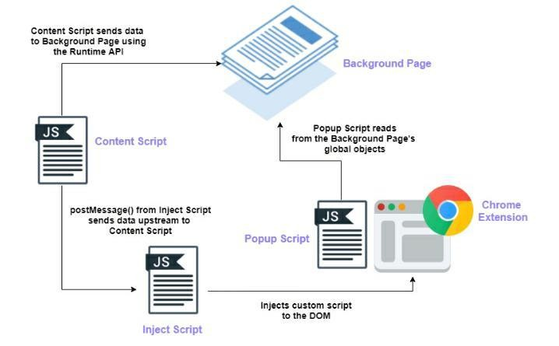
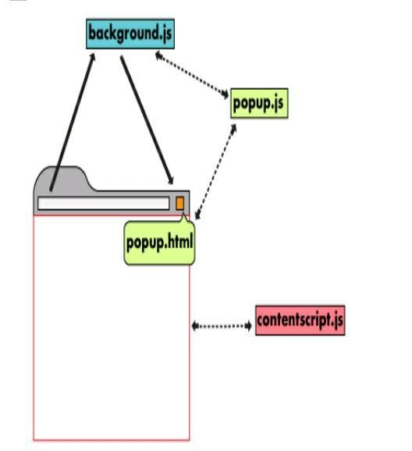
Context Diagram
The context diagram is a top-level view of an information system that shows the boundaries and scope. It describes the main objective of the system and the entities involved.

Slide 13
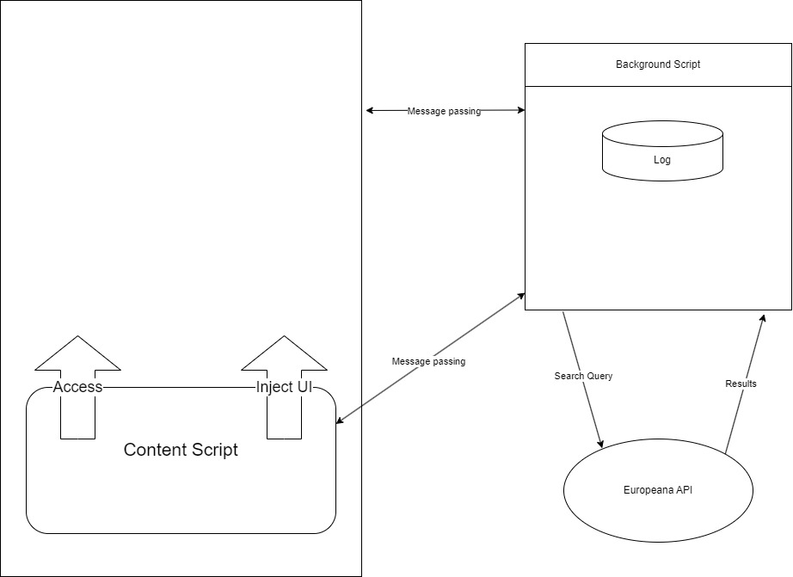
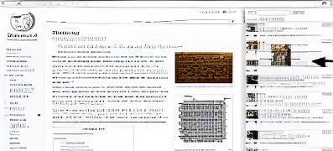
E-R diagram

Slide 14
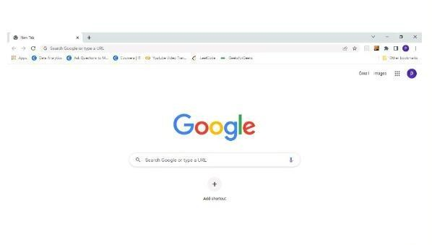

Google Chrome browser Home Page
Google Chrome Icon

Slide 15
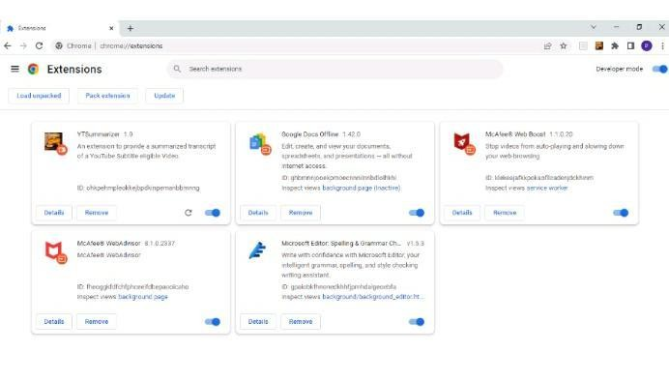
Google extension storage

Slide 16
Conclusion And Future Enhancement Limitations
The newly developed system represents a notable advancement in meeting user requirements, yet it is not without limitations. Specifically, its summarization functionality is currently constrained to a maximum of 1024 words, occasionally resulting in suboptimal accuracy. Nevertheless, the system holds promise for future improvements through the integration of updated backend models. This indicates a commitment to enhancing summarization capabilities, thereby ensuring greater utility and efficacy for users.
Accuracy of summary
The existing system does not provide high rate of accuracy and its hard to be only dependent on this
model for future works because this might lead to make us miss some good video content if summary is not all accurate enough.
Audio accuracy and quality
The system currently does no provide audio summary of larger videos because its hard for low -level
modules to generate huge amount of summary and process it, it does not have the capability to
process large transcription
Subtitle eligibility in videos
The existing system has the eligibility criteria for a YouTube video to generate summarization in
whatever required format because it cannot transcribe the improper language audio to transcribe
summary of a video, this leads to one single criteria to generate only subtitle in-built videos to
generate summarization.

Slide 17
Future Enhancements
The new system would contribute to the overall objectives to of the Extension. It would provide a quick,
error free and zero cost solution to the current process. It would provide a solution to many issues in
the current system. As the new system is flexible and scalable it can also be upgraded and extended to meet other complex requirements which may be raised in the future.
Features of the New System
The new system has been designed as per the user requirements so as to fulfill almost all of them below:
Speedy Processing :-Summary can be generated very quickly as compared to the existing extension as
it allows the use of previously generated summaries to see again with data stored on cloud. It saves time required to get the summarization of audio and text faster.
Accuracy :-One of the most important draw backs of the current system is that audio is not at its best
accuracy and can’t be generated on longer size videos because of word limit. The new system will
generate the result as soon as the summarization is processed by user and will also store it in the database for future usage.
High-quality Audio :-The new system makes it easy to store and retrieve information as required and
does not involve storing information by the user-self its on Auto mode from cloud. It thus saves data
management problems faced in the current system as it has a Database Management System of only one-time access.
Zero Cost and No :- Advertisements Unique service provider this extension as it does not show any advertisements and provide no-cost service

Slide 18

Version 3 with Treasure data
Integrating with Treasure Data offers an opportunity to enhance the capabilities and insights of our software system. By seamlessly incorporating Treasure Data into our architecture, we can leverage its powerful data management and analytics features to enrich our data processing capabilities.
Through this integration, we can streamline the collection, storage, and analysis of vast amounts of data, enabling more informed decision-making and actionable insights. By tapping into Treasure Data's robust platform, we can efficiently manage and analyze data from various sources, including user interactions, system logs, and external data sources.

Slide 19
Conclusion
The development of software is a collaborative endeavor, involving various stakeholders such as system users, developers, and management. A crucial initial step is to identify system requirements through comprehensive data collection, enabling effective interaction with both suppliers and customers. Subsequent to this foundational stage, proper design emerges as a blueprint, guiding the implementation phase executed by developers.
Recognizing the significance of systematic documentation, all processes are meticulously executed using a software engineering approach. Operating within a live environment offers invaluable insights into the intricacies inherent in the System Development Life Cycle (SDLC).
Through active involvement in this project, I have accrued substantial practical knowledge, which I believe will position me favorably for future endeavors.

Slide 20


Slide 21
Bibliography-
https://huggingface.co/transformers/installation.html
https://pypi.org/project/youtube-transcript-api/
https://www.thepythoncode.com/article/text-summarization-using-huggingface- transformers-python
https://medium.com/swlh/parsing-rest-api-payload-and-query-parameters-with-flask- better-than-marshmallow-aa79c889e3ca
https://medium.com/better-programming/the-ultimate-guide-to-building-a-chrome- extension- 4c01834c63echttps://developer.chrome.com/docs/extensions/mv2/user_interface/
https://www.thepythoncode.com/article/translate-text-in-python

